Slide 1

SG Performance Excellence
Engineering
Induction Training Program
(E-ITP)
Project Management
Part 4

Slide 2
Project Case Study:
MIEL “Project 5”
Notes:
After reviewing the overall project life cycle within GSG let us take a few minutes to observe a generic case study project run in MIEL.
Let’s look for the basic components and practices that we have talked about in this thread as well as look for specific tools and mechanisms that the project used to manage the project to a successful conclusion.

Slide 3
The Beginning
A major Motorola Division in search of vendors for critical components of their complex product in an leading edge technology area .
Notes:
All projects start with a customer with a problem and so begins this project.

Slide 4
A Motorola
Group
VENDOR
EVALUATION
Company - A
Company - B
…
…
MIEL
…..
…..
Unconditionally Qualified
Notes:
The customer did not just select MIEL as their supplier but evaluated MIEL
This is a common practice among many Motorola organizations… they look at the business profile of the organization as well as specific technical aspects of their product development organizations
This customer found MIEL to be an “unconditionally qualified vendor” based on people and process and technical competence.
SEI L5 helped…

Slide 5

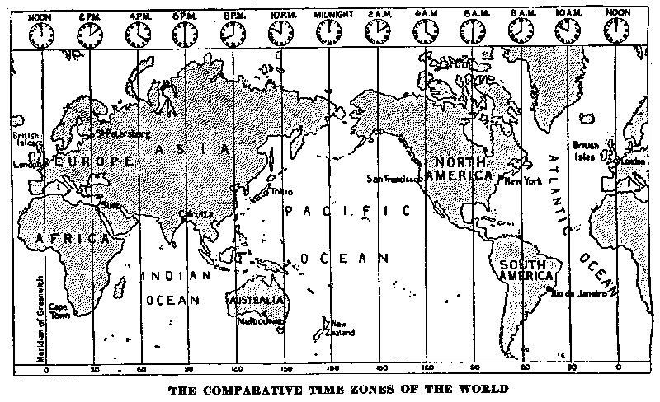

CUSTOMER
MIEL, Bangalore, India
Notes:
Nevertheless there were concerns expressed by Motorola Division.
How well will a, 4 year old Indian software company located 6 time zones away, can develop the software on time?
What concerns do you think that they had… and what can be done to reduce the risks that might exist?

Slide 6
Kick-off of Program X
MIEL Evaluation: The proposed program would be a key component of the organizational roadmap in the areas of:
  Communication Tools
  Network Management
Negotiations: Based on what is available in terms of:
  Domain Competency
  Reusable components and product lines
Notes:
From the MIEL perspective the projects that the customer had were important to the overall Center strategy and roadmap to become key providers of products in the tool and NM areas…
An initial evaluation also identifies items that the organization needs to know and consider such their knowledge of the domain and how they could ensure that their team has the required competency… also the availability of reusable product assets in the product lines that would be dealing in… these are items that can be explored and negotiated with the customer
What experience has MCSC had in this…???

Slide 7
Program X Planning (1)
Program Manager identified
Rules of engagement defined
Set of initial projects identified for about 70 people
Notes:
So you can see that a set of initial projects were identifed… from our earlier materials what is the term for a project consisting of many related projects (or projects shared between Centers). (this is a program…)
How do you think that they identified the initial number of resources required?

Slide 8
Program X Planning (2)
Domain specific technologies identified, tools procured
Domain specific processes defined
Competency development planned
  Training on Program specific technologies, tools
  Visits to customer sites
Notes:
Did you consider these in your ITP project?

Slide 9
Program X
Project A
Project 5
Project E
Project C
Project D
Notes:
So, we have identied this set of linked projects… in the program
now let’s look at some detailed activities related to one of these projects… we will call it Project 5

Slide 10
Project-5 Overview
Developing critical components of a Network management system
Tight deadlines
New technology of distributed computing was needed
Estimated team size of 30
Notes:
Project 5 consists of components in a NM system…
The initial constraints and scope start to define the nature of the project...

Slide 11
Ready - Set - Go: Project 5 ...
Project Initiation
Notes:
As with all projects in GSG the project starts with an Initiation phase…
What activities would you expect to be done here?

Slide 12
Initiation of Project-5
Core Project Team identified
Key technical and managerial needs of the customer identified.
Proposal prepared considering MIEL’s capabilities, resources, possible opportunities, risks and issues.
Project negotiated based on win-win strategy in an open atmosphere.
Project mission and goals defined
Strategy for customer delight developed
Notes:
Who do you think is on the Core Project Team? What roles?
The Win-Win strategy comes from the Theory W management theory and approach which says that making winners out of the systems key stakeholders is a necessary condition for project success. Barry Boehm has used this strategy in requirement capture as well as the entire spiral model… his WinWin Spiral model adds Theory W activities to the front of each cycle… there is also a groupware tool to facilitate stakeholders in negotiating satisfactory system specifications.
Do you remember earlier discussions of Customer Delight? What did you do in your ITP projects to delight the customer?
What other activities take place in this stage of the project? What are our exit criteria to move to the next steps?

Slide 13
Project Initiation
Requirements Definition
Project Planning
Notes:
From initiating the project we can move into defining requirements and detailed planning… starting to refine and capture the requirements will allow us to get a better picture of the project...

Slide 14
Initial Requirement Definition
Participated with the Customer’s Systems Engineering Group for
  Software requirements definition
  Systems architecture development
Identified components to be developed in multiple threads at MIEL
Identified the required product Q attributes
Notes:
Starting to document assumptions and open issues are very important to start here if this has not begun already…
How would you do this in this activity?
What quality attributes do you think would be important to identify?

Slide 15
Product Quality Metrics
Reliability
Scalability
Performance
Mission Critical
Breakdown < 24 hours
Non-Stop uptime
Reliability of Data
Reliable Error Handling
Test Coverage
Process Distribution
System behavior upon bounds exceeded
Performance Changes
Data Sourcing
Layered Architecture
What Features in what Box
Memory Usage
MIPS
Throughput
Call Rate
Timing Constraints
Response Time
Start Up Time (Cold/Warm)
Common Themes
Exception Handling
Real time Even handling
Common look & feel
Follow Industry standards
Usage of COTS
Product Quality Attributes
Addition of new functionality
Customizability
Performance changes
Architecture Flexibility for
changes
Types of Interfaces
Clear ICD definitions
Conformance to define interfaces
Assumptions about interfaces
Ease of Interface debugging
Modifiability
Interface Complexity
Reusability
Product Quality Attributes are Identified, Specified and Prioritized as part of Requirements Process
The Attributes are tracked subsequently during different life cycle activities and Reviews.
Notes:
Here is how these teams considered and identified the quality requirements and measures of those attributes within the project.
What kind of chart is this? (fishbone or Ishikawa diagram) Have you made use of it or the concepts it uses?

Slide 16
Project Initiation
Requirements Definition
Project Planning
Notes:
With developing information on the project’s requirements we can increase the level of detail in our planning…

Slide 17
Project Goals
Goal Setting
Setting Project Goals based on
  Organizational Goals: Quality, Productivity, Cycle Time
  Customer Needs
  Challenges taken by the project team
  Individual Goals and PSP
Project Planning
Notes:
What are examples of the goals that you set for your IPT project… which are most important… how did you tell if you met your goals?
PSP is the Personal Software Process as described by Watts Humphrey… MIEL and other Motorola organizations use the PSP’s concepts to allow specific team members to set personal goals for improvement

Slide 18
Make Vs. Buy
Systems Engineering Group
Goal Setting
Systems Solutions Group
Project Planning
Make Vs Buy
Identification of assets and COTS products
  Internal communication tool for load testing identified
  COTS SNMP protocol stack identified
Notes:
Early identification of assets that can be reused or purchased can impact the project… how does reusing and purchasing impact the project… and it’s goals?
How would you go about identifying items to Buy versus Make...

Slide 19
Productivity Tools
Goal Setting
Tools Survey
Make Vs Buy
Project Planning
Application
Frameworks
Middleware
Productivity
Codecheck
Purify
Teleuse
Imake
ACE
RogueWave
G2
Test
Tools
Software Engineering Group
Purecover
Quantify
XRunner
Notes:
During this time the project also identifies the development environment… and how it can impact the project goals.
How would you currently survey tools for use on a project?
What role did that we discussed today could add support to this activity? (… the SETC)

Slide 20
Tool Usage Results
Public Domain SNMP agent
Size of Code reuse : 11 K of ‘C’ Code
Effort Save: 14 Staff months
Teleuse GUI Code generator
Size of Code reuse : 45 K of ‘C++’ Code
Effort Save: 90 Staff months
Xrunner to automate Test case execution
Reduced execution time from 2 weeks
for 396 test cases to 2 days
CTR Gain :5 X
Notes:
Here are some of the tools this project selected and why...
Public Domain SNMP agent
Size of Code reuse : 11 K of ‘C’ Code
Effort Save: 14 Staff months
Xrunner to automate Test case execution
Reduced execution time from 2 weeks
for 396 test cases to 2 days
CTR Gain :5 X
Teleuse GUI Code generator
Size of Code reuse : 45 K of ‘C++’ Code
Effort Save: 90 Staff months
MIEL ended up recommending about 45% percent of all the tools used in the IRIDIUM Network management program. This was completely due to a tools initiative in the organization

Slide 21
Process Composing and Optimization
Multi-threaded Spiral model
Goal Setting
Make Vs Buy
Project Planning
Process Composing
Software Engineering Group
Notes:
At this time the team had enough information on what they were building, the constraints they faced, etc. so that they could select a process for the project.
Do you remember the Organization’s Standard Software Process and the Project Standard Software Process? What are these and how do they come about? How do they benefit the organization and it’s projects?

Slide 22
Goal Setting
Make Vs Buy
Project Planning
Process Composing
Project Organization and Systems
Notes:
Project organization allocates the product strategy and process activities… this provides an initial project architecture that allows the team to start to answer “how is this really going to happen”

Slide 23
Project 5
Thread # 1
Thread # 2
Thread # 3
Technical Direction
Tracking & Oversight
Configuration Management
Project wide config Management
Project wide Tracking & Oversight
Common Build, Integration & Test
Notes:
Since Project 5 has defined a series of deliverable threads this is taken into account… what development phases might this delivery method impact? How?

Slide 24
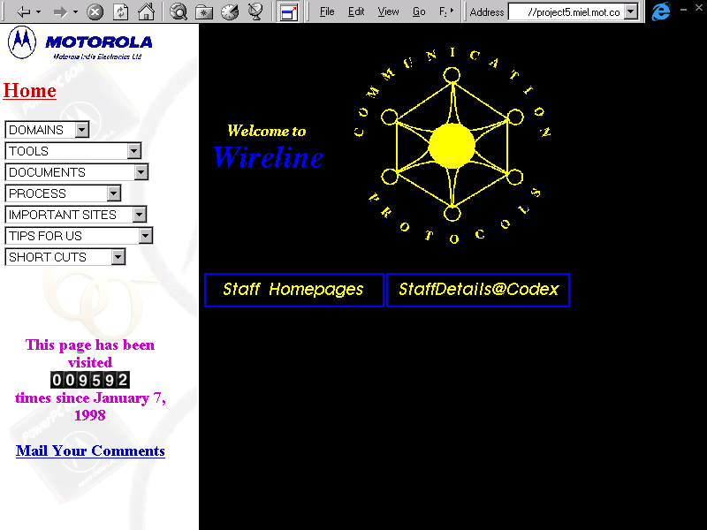
Project Intranet
Notes:
As we have seen when we discussed project start-up and infrastructure a useful project tool is the project web site…
What does the project web site add to the project?

Slide 25
Goal Setting
Make Vs Buy
Process Composing
Project Planning
Project Organization and Systems
Estimation and sizing
Notes:
With information on the nature of the product we can produce better estimates with which to plan development...

Slide 26
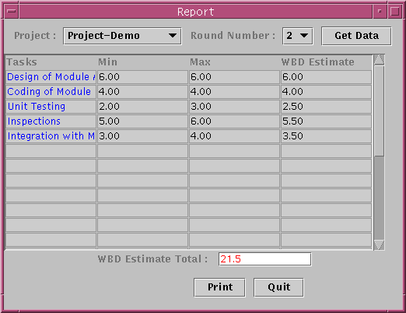
Wide Band Delphi Estimation
Notes:
Tools can assist the project with estimation as illustrated here…
What is Wide Band Delphi Estimation….?

Slide 27
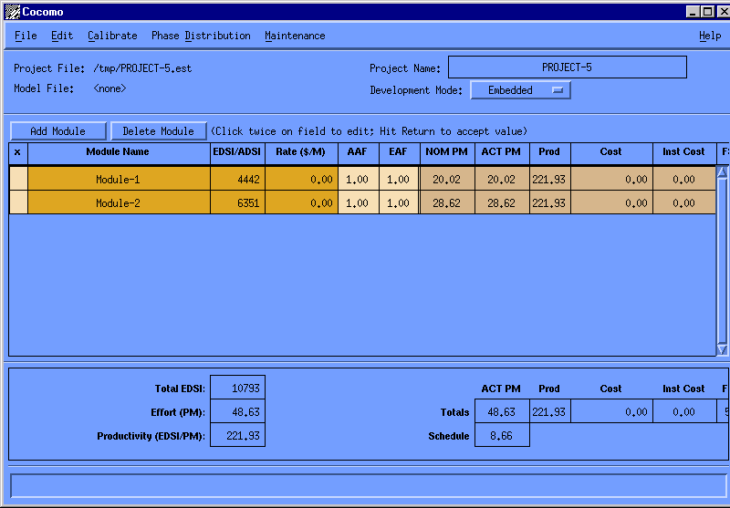
Validation Using COCOMO
Notes:
Why is it important to validate estimates?
What are methods to validate estimates?
Tools such as this use a formal method to provide estimates with which to compare to the current or past data.

Slide 28
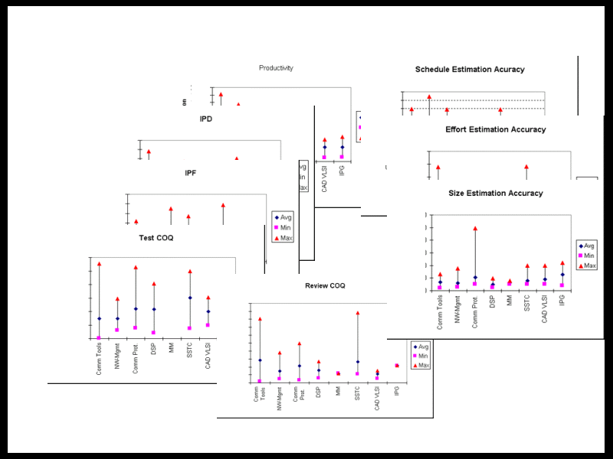
Using Domain Baselines
Notes:
Baselines prior project data is valuable is many ways… setting goals, measuring improvements, and in the Estimation process

Slide 29
Detailed Planning
Scheduling
Risk Management
Reviews Planning
Planning for organizational activities such as Taskforces, Peer audits, Training, Proposals for new projects etc.
Training plan
Finally... the Management Review
Notes:
Identifying detailed information and plans for how to develop the product(s) of the project allow for the scheduling of specific activities and resources.
What is done in the Management Review…?

Slide 30
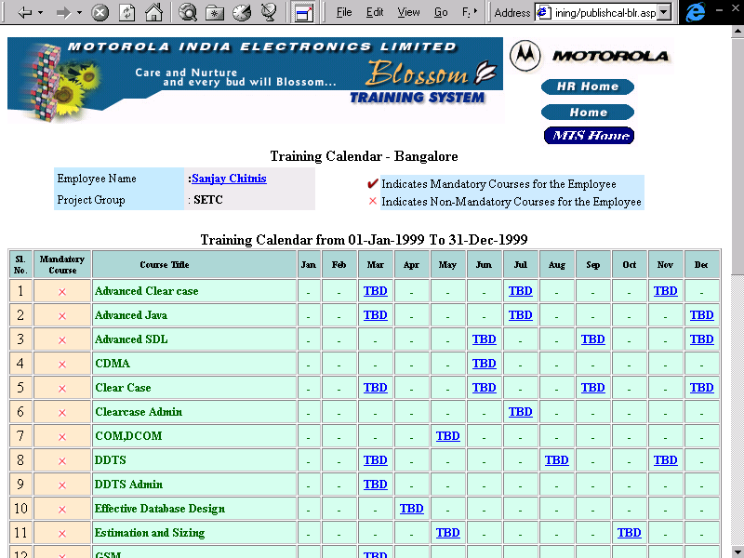
Training Plan
Notes:
Training is an important part of the project as well as the organization.
This shows a web-based tool that is used at MIEL… what mechanism will MC use?
What training listed here would you expect to also benefit from?

Slide 31
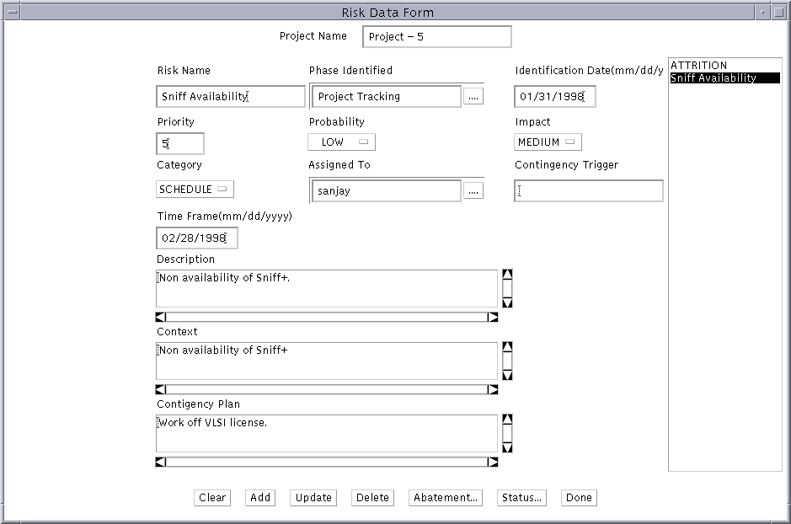
Risk Management: Planning
Notes:
An industry best practice is to identify and manage risks from the very start of a project.’
Project 5 can use this tool from MIEL to identify, track and mitigate or better yet prevent risks from becoming serious issues.
How else can a project team manage risks…
Where is risk management defined for the project team? (SPMP)

Slide 32
Development & Tracking
Project Initiation
Requirements Definition
Project Planning
Architecture
Development & Tracking
Notes:
We have seen that planning is a critical item contributing to overall project success… but the most important element is actually building the product!
During implementation the project must be managed… it is here that the plans become real and by tracking status and progress the decisions on how to control the project can be based on data and thus be less risk prone that managing without it. As we remember from the prior MIEL slide… tracking is an important contributor to project success.

Slide 33
MIEL Tool: Integrated Project Management Suite
Estimations
Requirements
Risks
Config Items
related data
Size
Effort
Time
Fault
related data
Planning &
Tracking
Environment
Integrated
Quality Metrics
Environment
Organizational Database
Metrics Charts
Trends
Process Control
Triggers
Baselines
Notes:
At MIEL they have built a tool. IQMEn with which the projects and organization can capture data and use the data to report status and make decisions
What elements of this data did you capture and use in you ITP project?

Slide 34
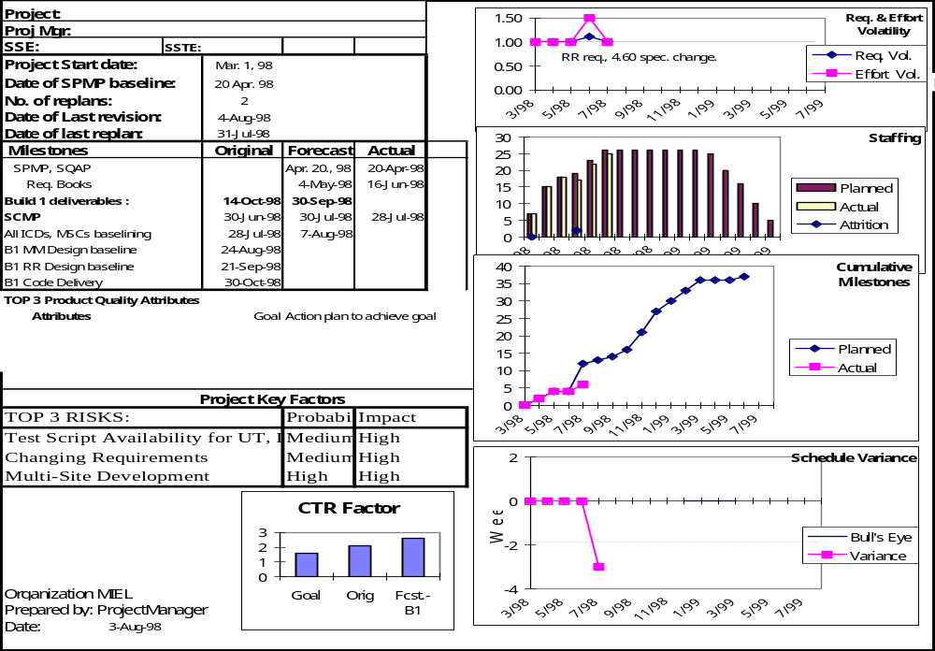
Project Tracking and Oversight Chart
MIPS
ROM utilization
RAM utilization
Notes:
Here is a chart that is produced by the IQMEn tool.
Does this chart remind you of one that you have used during the ITP? What is it called?
What metrics are different in this chart?

Slide 35
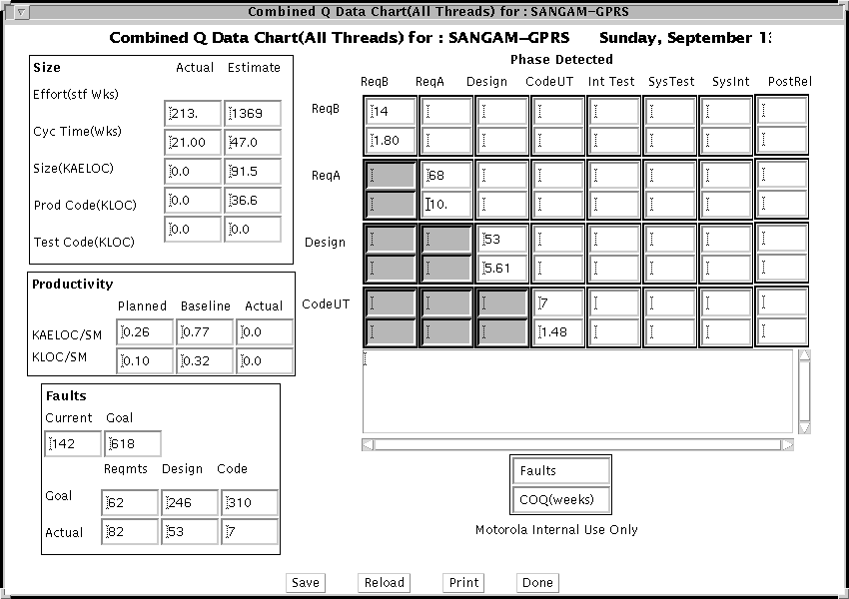
QData Chart
MIPS budget: 60 MHz (75% of 80 MHz processor)
Current MIPS: 47 MHz
Notes:
Here is another chart that is produced by the data entered into the data repository through the elements of the IQMEn tool.
This chart should also look familiar...

Slide 36
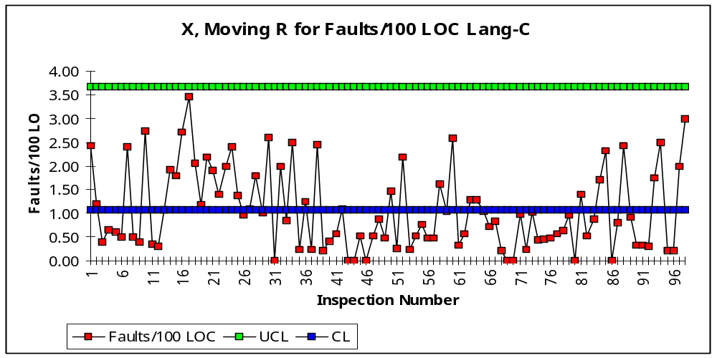
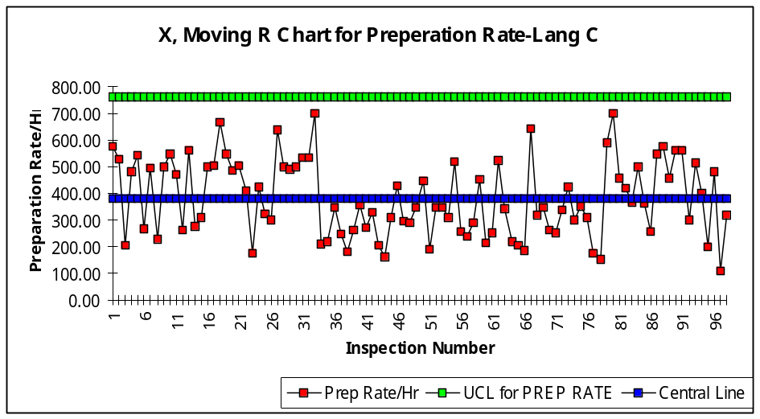
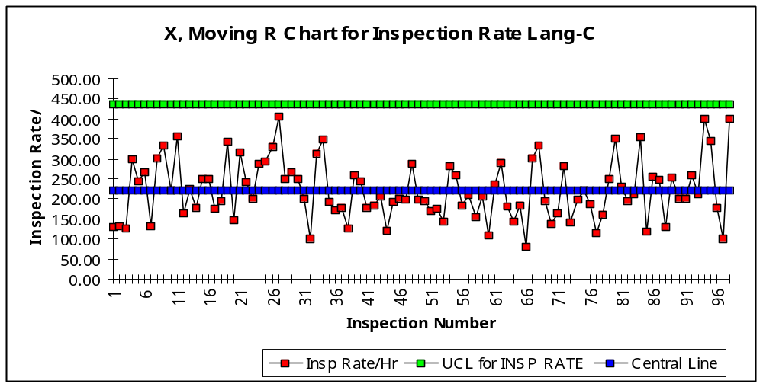
Sample Control Charts:
Establishing Control Limits
Notes:
IQMEn also provides the data with which to provide control charts for use in identifying the sources of variation in the process.

Slide 37
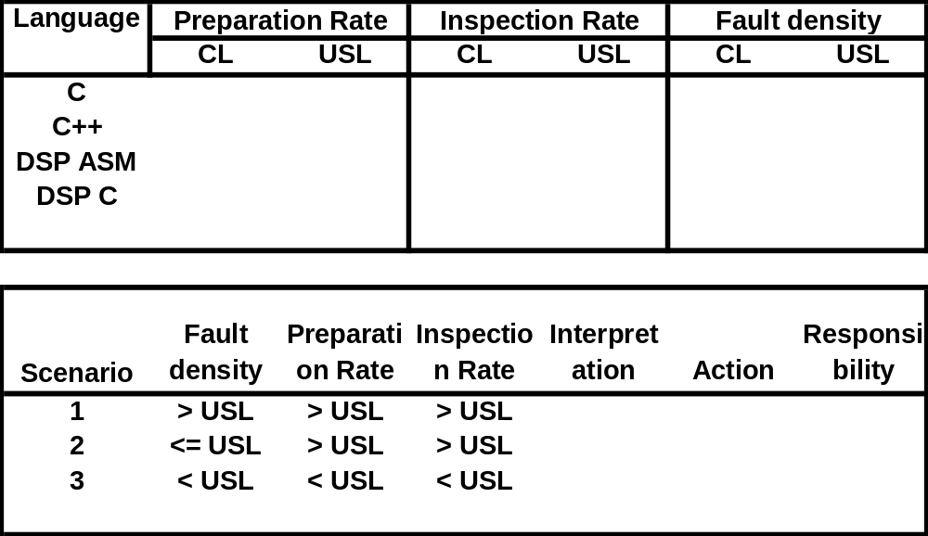
Control Table / Scenario Table
(multi-variable Control Chart)
The Integrated Metrics System sends the trigger mail to the Project Manager &
SQE when the limits are exceeded based on the scenario above.
Notes:
Another useful feature of the tool sends mail to key project roles when certain values are exceeded while carrying out the project’s process.
What other triggers might be useful for a project or development team?

Slide 38
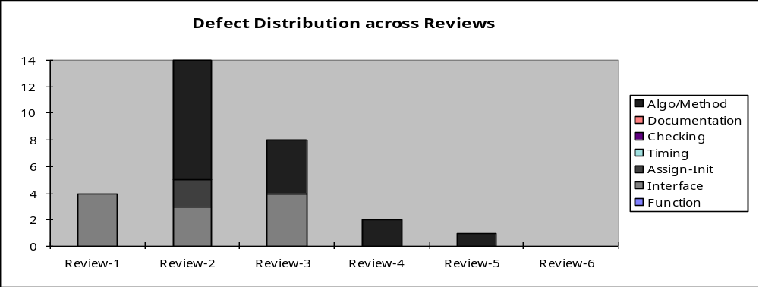
Defect Prevention using ODC
High number of interface and algorithm type of problems were found in the first three reviews.
Causal analysis and action planning at the end of first three reviews prevented these kind of problems in the subsequent reviews.
Notes:
With error data saved in the database along with the metadata that describes the data in terms of the ODC method one can use this data to start to attack the source of problems within the project… as here with Project 5 results.

Slide 39
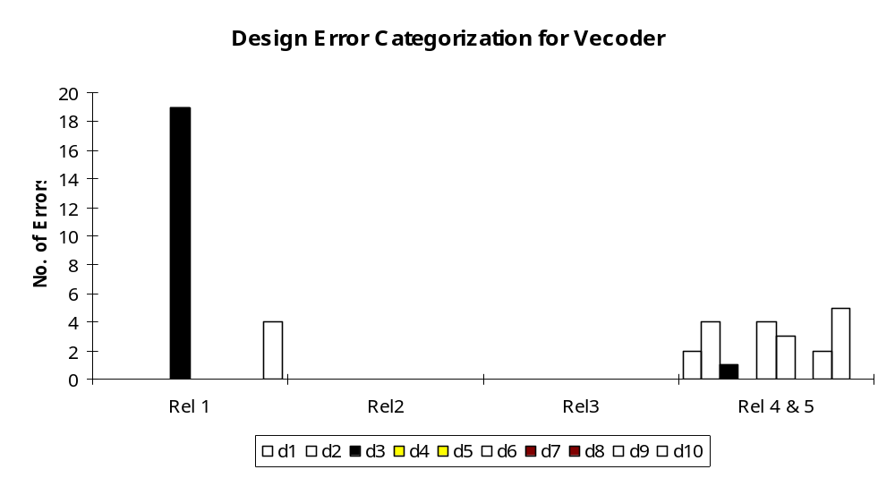
Defect Prevention
Causal Analysis
in Release 1
D5 (Interface)
Errors High
- Focus on ICD
- Interface Design review
- Updated Review checklist
- D5 Errors eliminated
in subsequent Releases.
- Over all faults reduced.
Notes:
This chart shows how Project 5 decreased a high level of specific errors found in Release 1 by concentrating on prevention (and early detection) activities… focusing on design elements, improving the reviews, etc. which resulted in decreased levels of the D5 errors

Slide 40
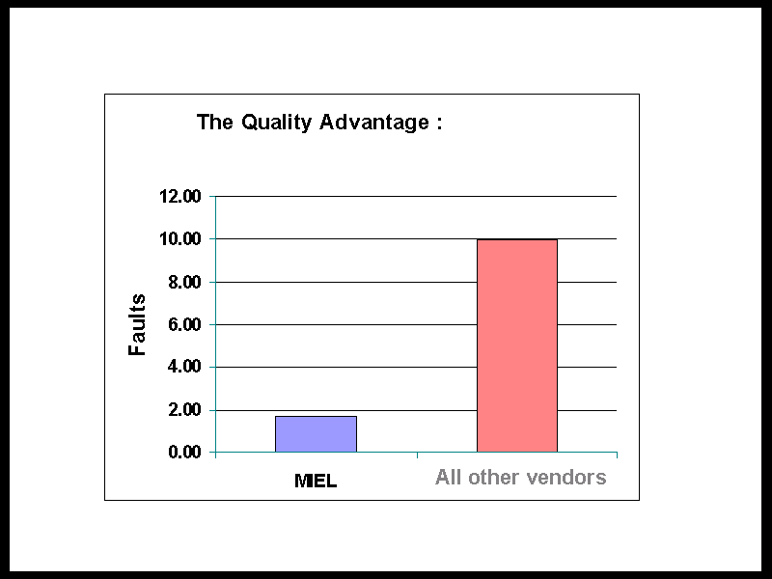
Notes:
The attention to reducing errors provide MIEL with an marketable advantage over other suppliers. This is a key component of this Vision of GSG.

Slide 41
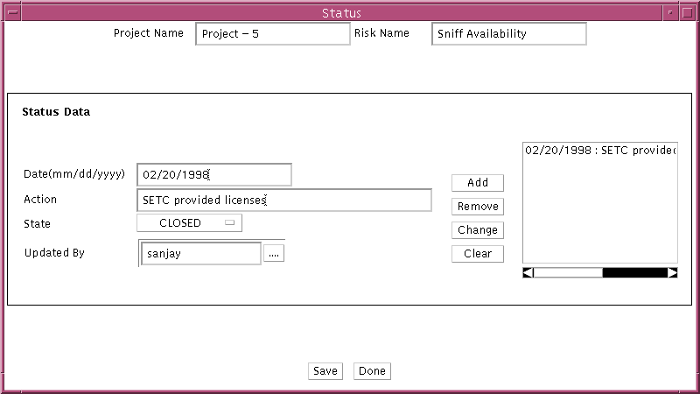
Risk Tracking
Notes:
By tracking project elements such as Risks… MIEL and Project 5 keep the commitments to the customer as well as that Quality advantage.

Slide 42
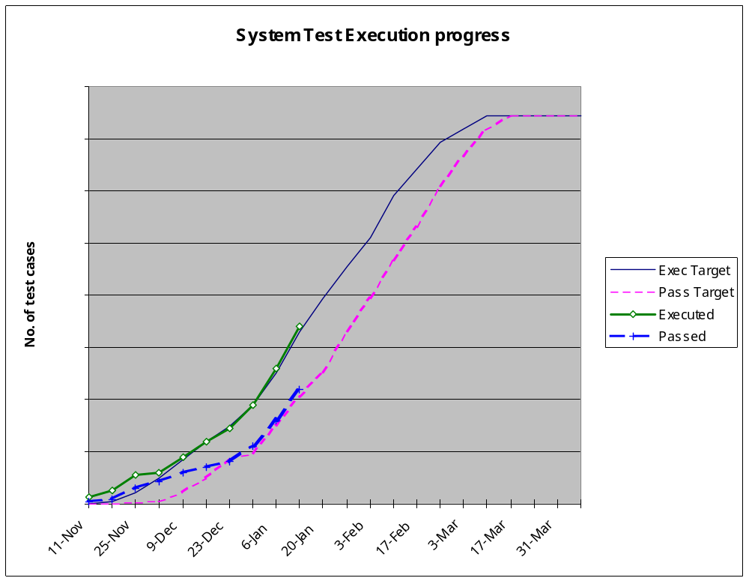
Test Progress Tracking
Notes:
Tracking continues from the constructive phases of the life cycle and into the testing phases… test planning, tracking and management is a key aspect in controlling a project… especially since testing still takes ~40-50% of the project time and resource.
Knowing how testing is progressing is critical to late estimates relating to product delivery… on time and meeting goals and criteria.
What can this tracking chart tell us about Project 5’s testing?

Slide 43
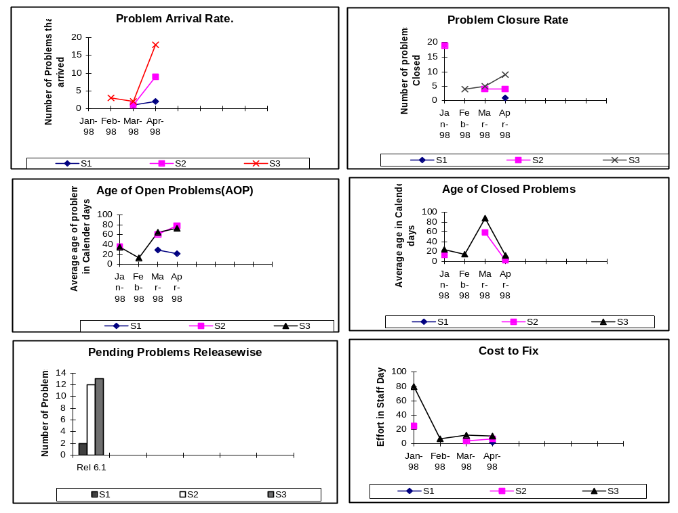
Tracking maintenance and support activities (Hypothetical data)
Notes:
We reviewed a sample maintenance policy from MASC… now we can see why Project 5 will use the following metrics to keep track of trends in detection as well as cost and time to fix problems within releases.
Problems in maintaining early threads to the customer could seriously impact the project team as it moves ahead to follow-on work. This needs to be evaluated in early planning and the project team and organizational history here will allow the project manager to estimate with less risk and more predictability.

Slide 44
Project Management Process Case Study
Questions ?
Comments?
Notes:
Any questions or comments on the case study?

Slide 45
Change History
Vers. A.1 31 Jul 2001
  New E-ITP PM Week 1-Part 2
Vers. A.2 06 September 2001
  Fixed format and typos
Vers. A.3 06 September 2006
  Gabriel Montes: Extracted slides and merged to Part 3. Part 4 contains only the case study.

